Slide 1



Slide 2
HEART ATTACK PREDICTION
Using Machine Learning Techniques
Guide : Sameer Warsolkar
Presented By : Asif Shaikh
Institute : IT Vedant
Course : DS&DA
Branch : Thane

Slide 3
Steps
Define the Problem(Problem Statement: Classification.
Data Loading.
Exploratory Data Analysis(EDA):-
Identification of variables and data types.
Graphical Univariate Analysis
Missing value treatment
Seperation of x and y
Train Test Split
Choose a Model
Train the Model
Evaluate the Model
Model Deployment

Slide 4
Problem Statement
Heart disease is one of the leading causes of mortality worldwide, making early detection and prevention critical for reducing the associated risks.
Developing a reliable predictive model for heart attack risk assessment can significantly aid healthcare professionals in identifying individuals at high risk and implementing preventive measures.
The aim of this project is to leverage machine learning techniques to predict the likelihood of a heart attack based on various medical and lifestyle factors.

Slide 5
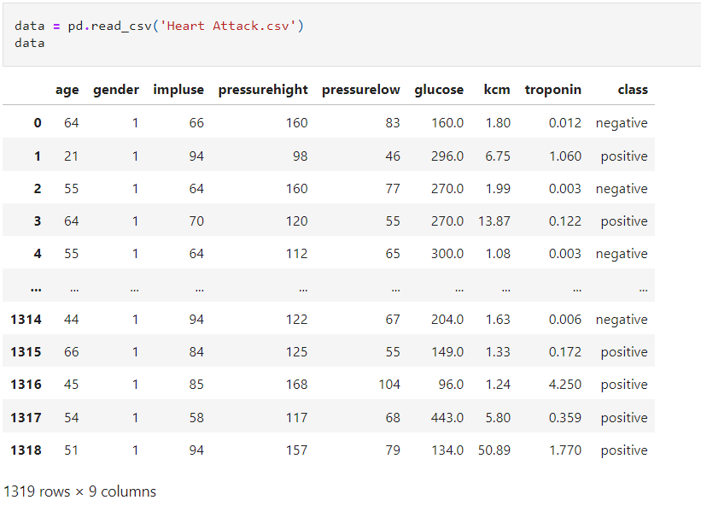
Data Collection

Slide 6
DATA DICTIONARY
age: Numbers wise
gender: Male or Female
impluse: The heart's electrical system produces electrical signals, or impulses, that cause the heart muscle to contract..
pressurehight: High blood pressure
pressurelow: Low blood pressure
glucose: Glucose and fatty acids are both fuel sources for the heart, helping it produce energy.
kcm: is a term or acronym related to heart
troponin: Troponin is a protein complex found in skeletal and cardiac muscle cells
class: the classification of something as negative or positive

Slide 7
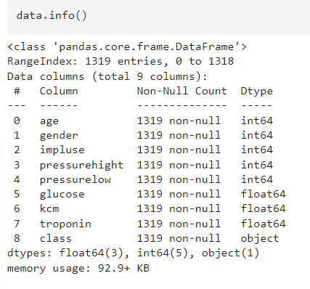
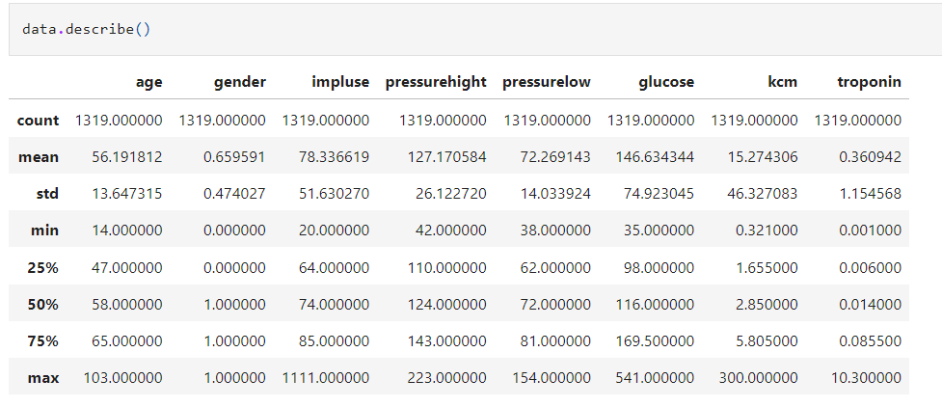
Data Info
Identify of Variables and data types
Non-Graphical Univariable Analysis

Slide 8
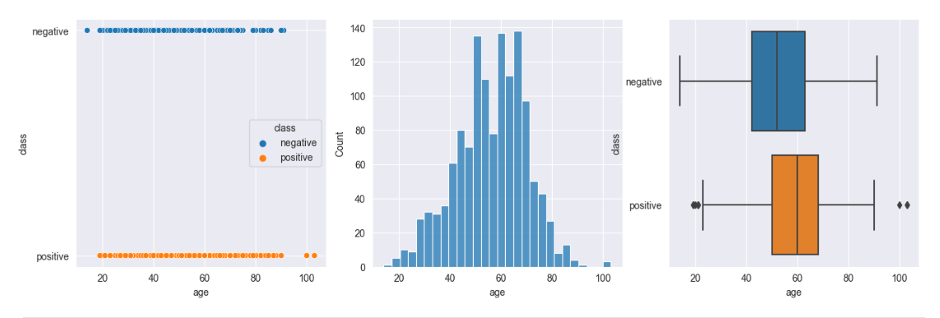
Data Visualization
AGE

Slide 9
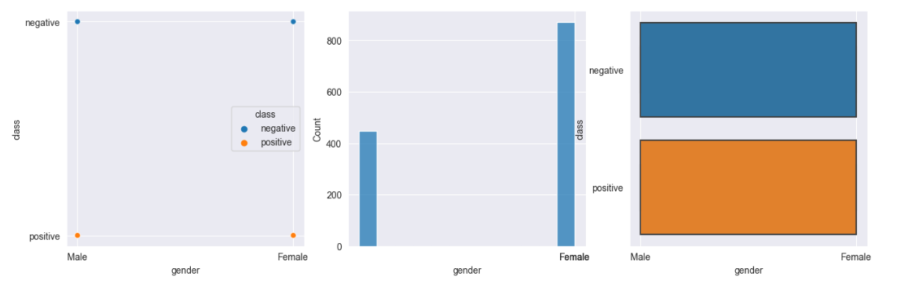
GENDER

Slide 10
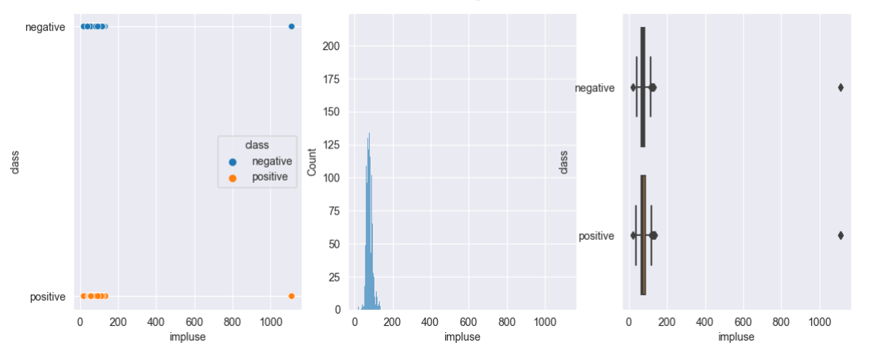
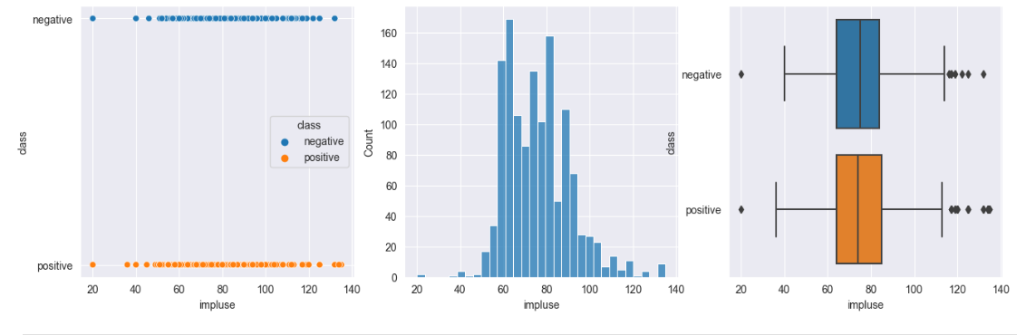
IMPLUSE

Slide 11
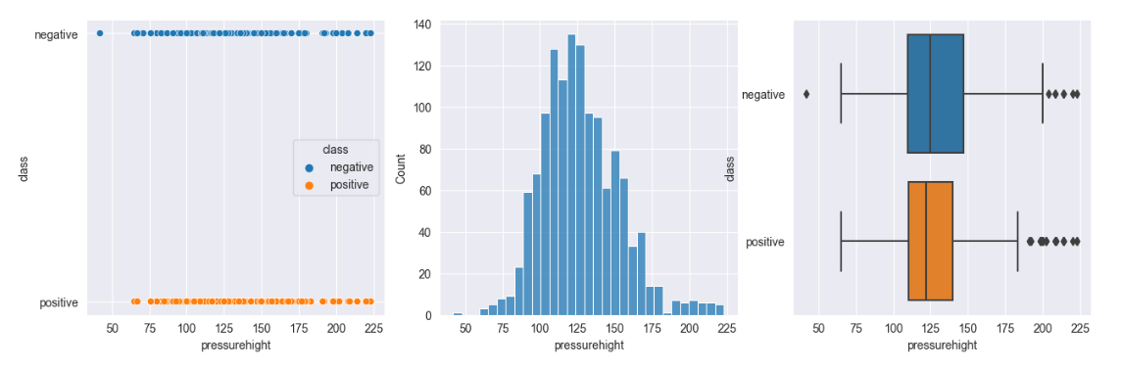
PRESSUREHIGHT

Slide 12
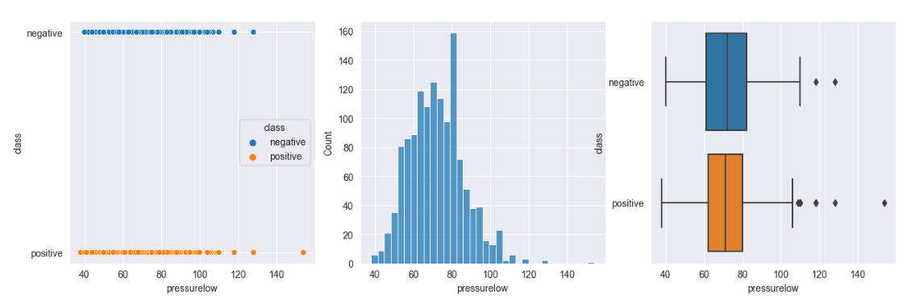
PRESSURELOW

Slide 13
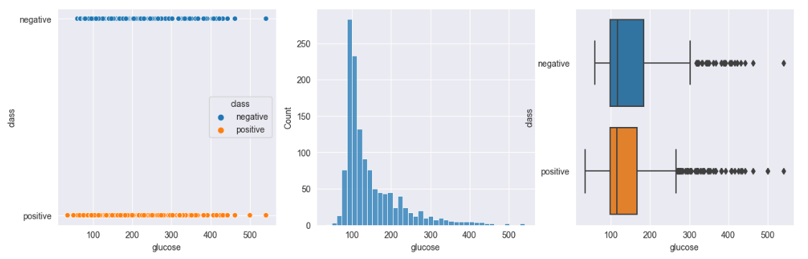
GLUCOSE

Slide 14
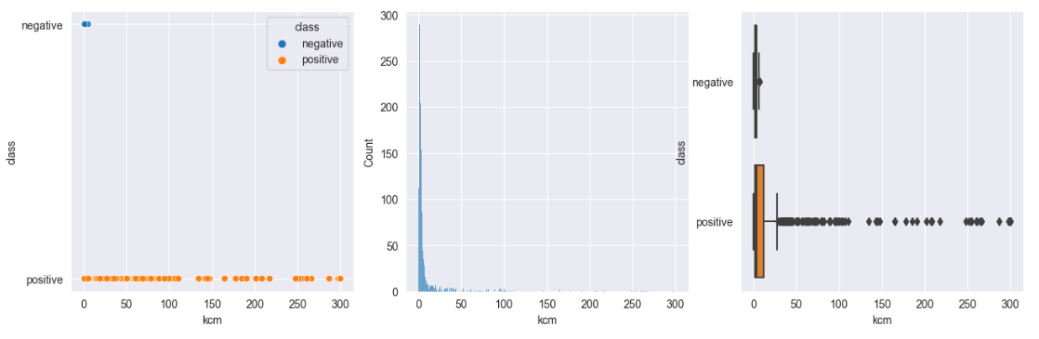
KCM

Slide 15
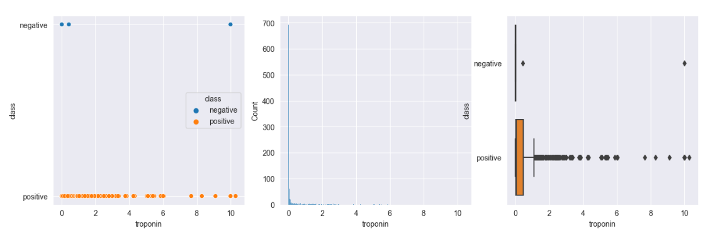
TROPONIN

Slide 16
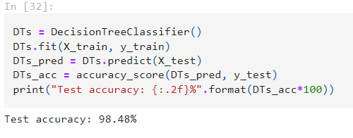
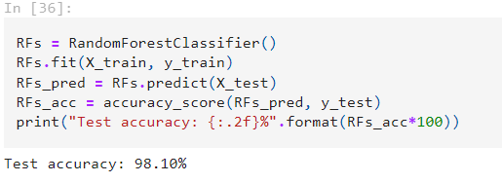
MODEL BUILDING
DECISION TREE CLASSIFIER
RANDOM FOREST CLASSIFIER

Slide 17
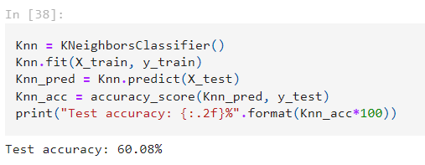
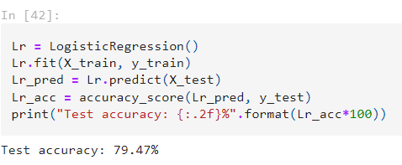
KNEIGHBORS CLASSIFIER
LOGISTIC REGRESSION

Slide 18
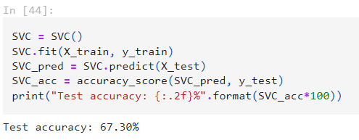
SVC

Slide 19
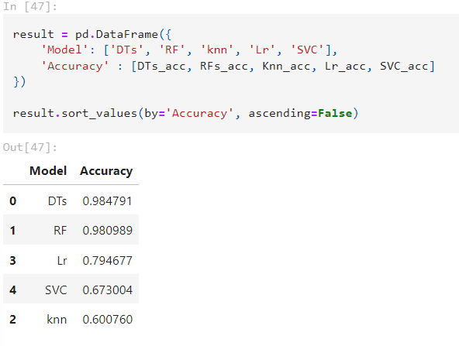
ALL MODEL IN ONE DATAFRAME

Slide 20
CONCLUSION
The order of the Best Models Accuracy from top to bottom is : DECISION TREE CLASSIFIER

Slide 21
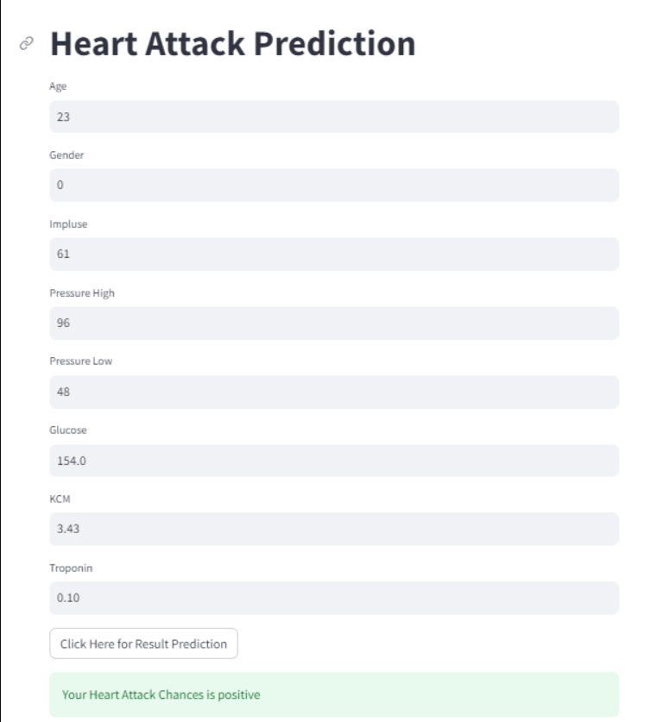
DEPLOYMENT
Tools and Libraries used-
Anaconda Navigator : Environment Creation
Pickle : Binary Conversion of data
Stream lit : Web App
Scikit-Learn : Linear Model

Slide 22


